Slide 1
CranSEDS
A Year in Review
CSA Clubs and Societies Awards Night
29th July 2022

Slide 2
Who are we?
Cranfield Students for the Exploration and Development of Space
Mostly SATM MSc students … but not all!
Wide range of nationalities and backgrounds

Slide 3
What did we do this year?
Competition projects
UKSEDs National Rocketry Championship
UKSEDs Satellite Design Competition
Olympus Rover Trial
EUROC – European Rocketry Challenge
UKSEDs MACH-22
Research project
Rocket Motor Test Stand
Outreach with local schools
CranTalks

Slide 4
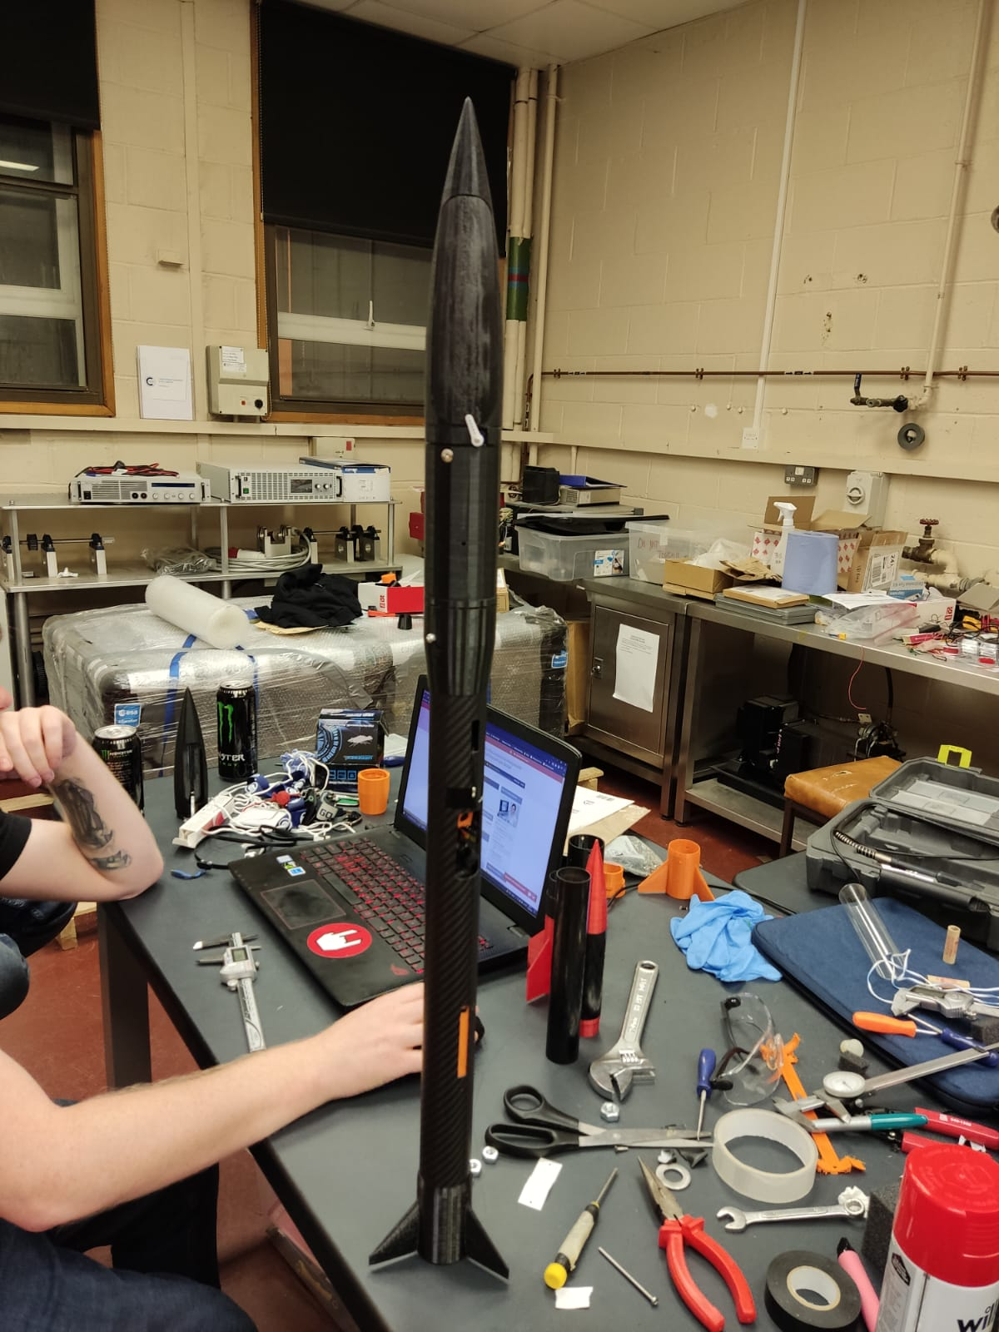
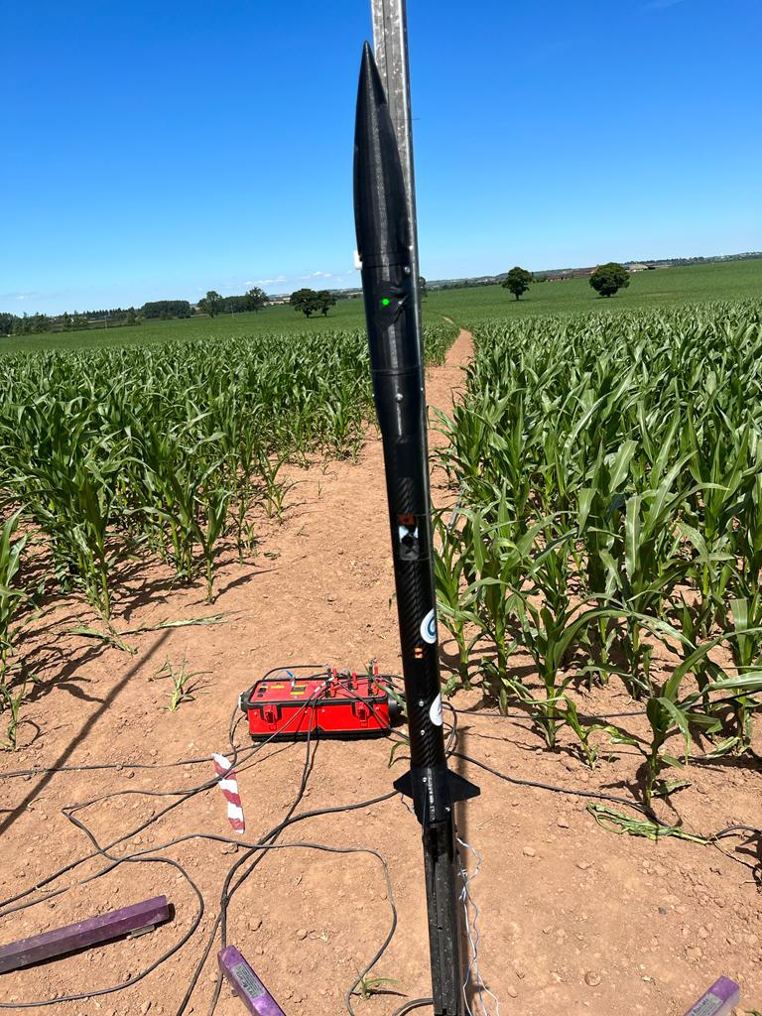
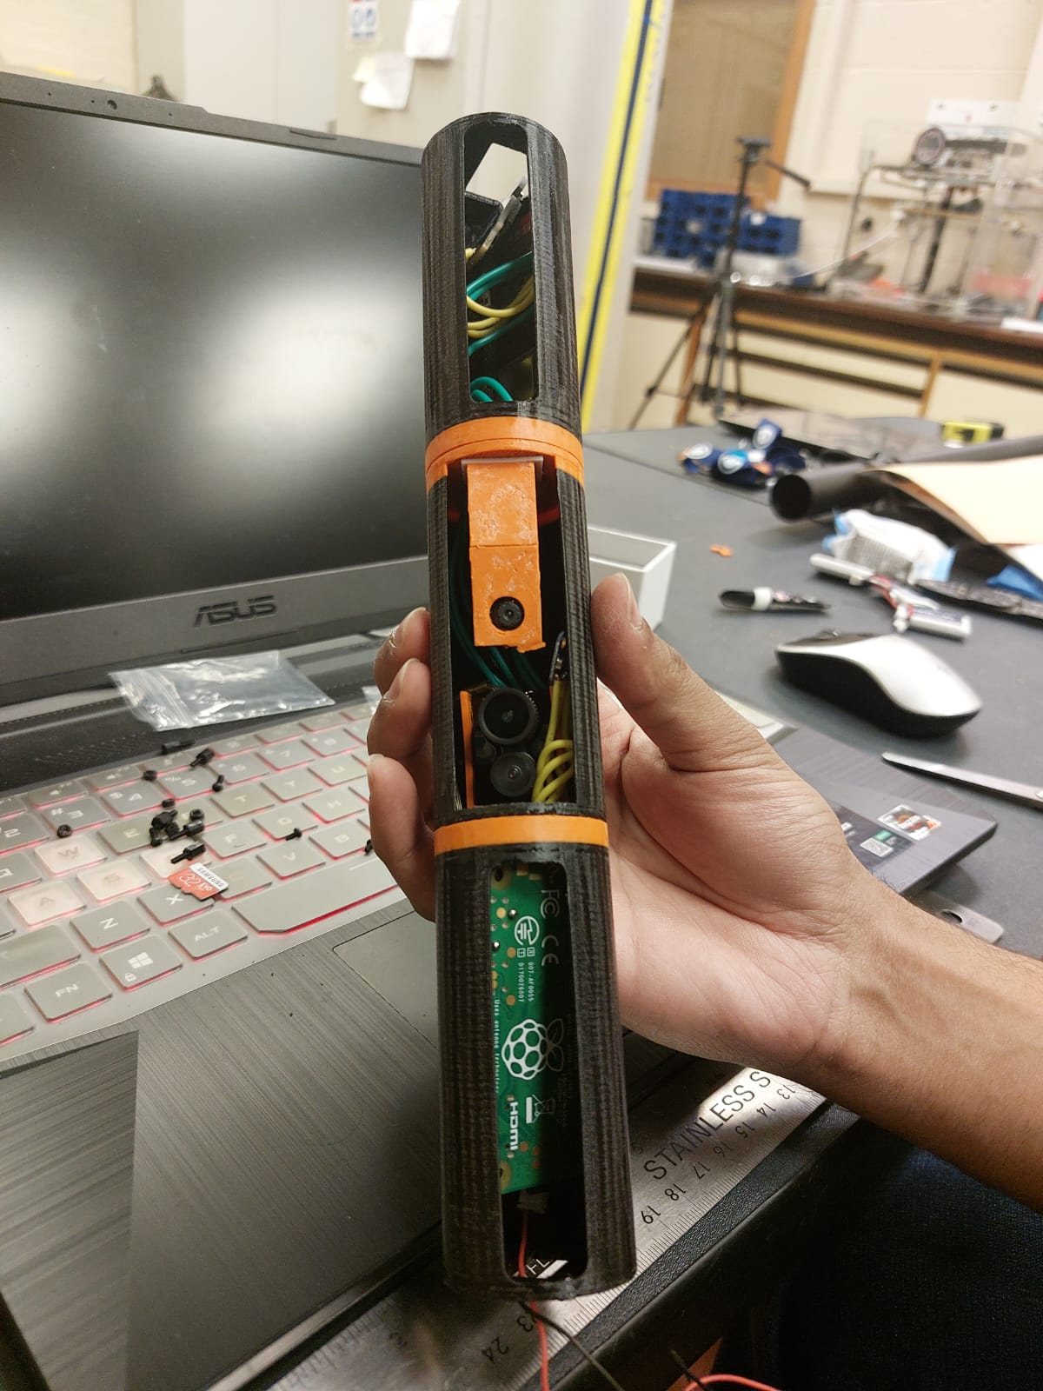
UKSEDS Orbex National Rocketry Championship
Maximum altitude for a given COTS solid motor
Ultra-lightweight rocket
Team of 20
Launch with Midlands Rocketry Club
Payload – Nature monitoring equipment

Slide 5
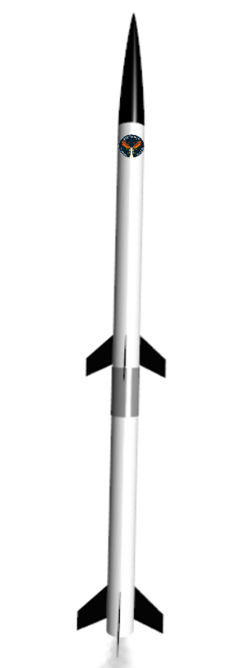
European Rocketry Challenge - EUROC
Designing a 2 stage 3km COTS solid motor rocket
Team of 30
Will launch in Ponte de Sor, Portugal in October 2022
Environmental properties measuring payloads

Slide 6
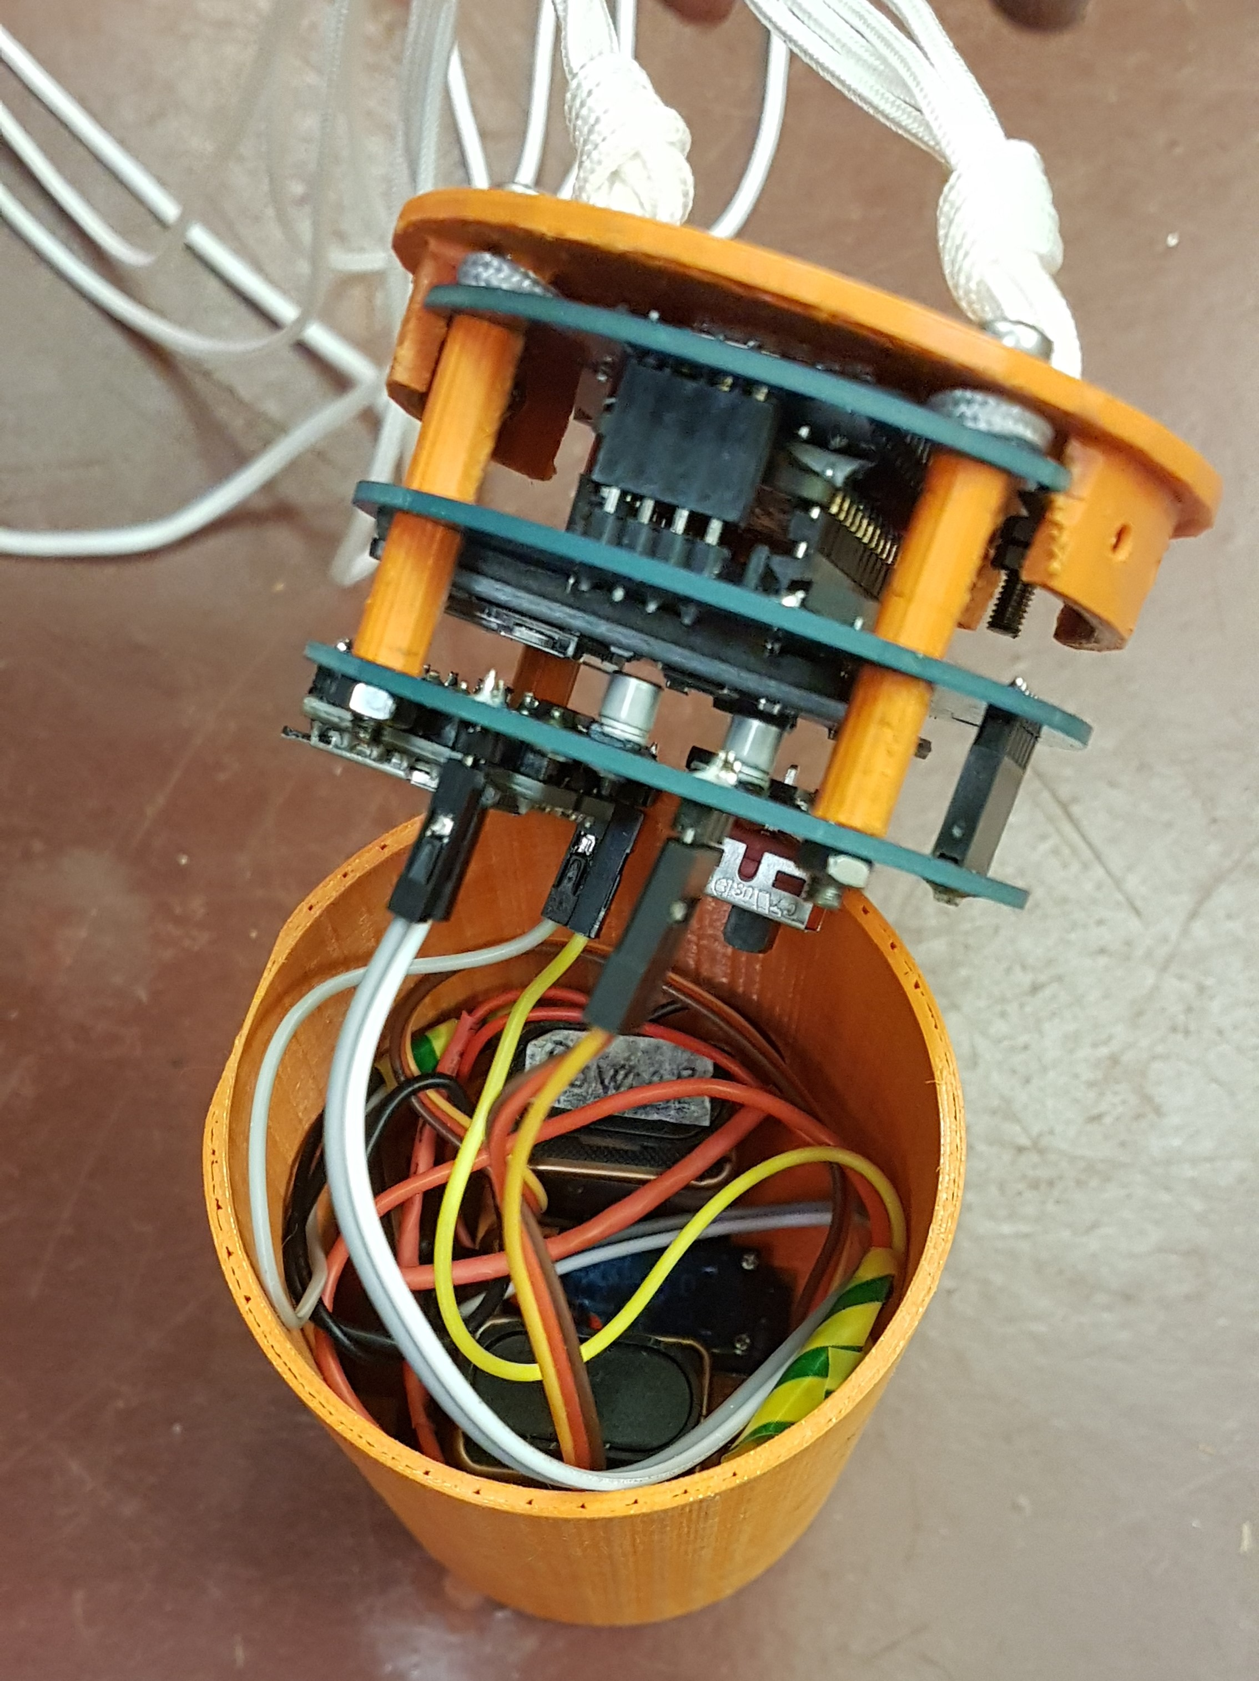
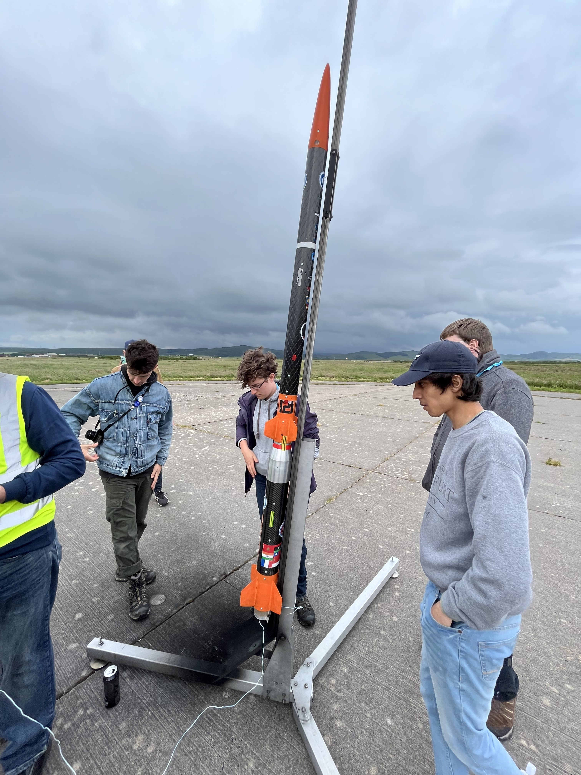
Mach-22 Rocket and Payload Team
Aim
2 stage 2.5 km solid motor rocket designed for EuRoC 2021
Launched in Scotland at the end of June
Payload
Deployable payload focused on biodiversity

Slide 7
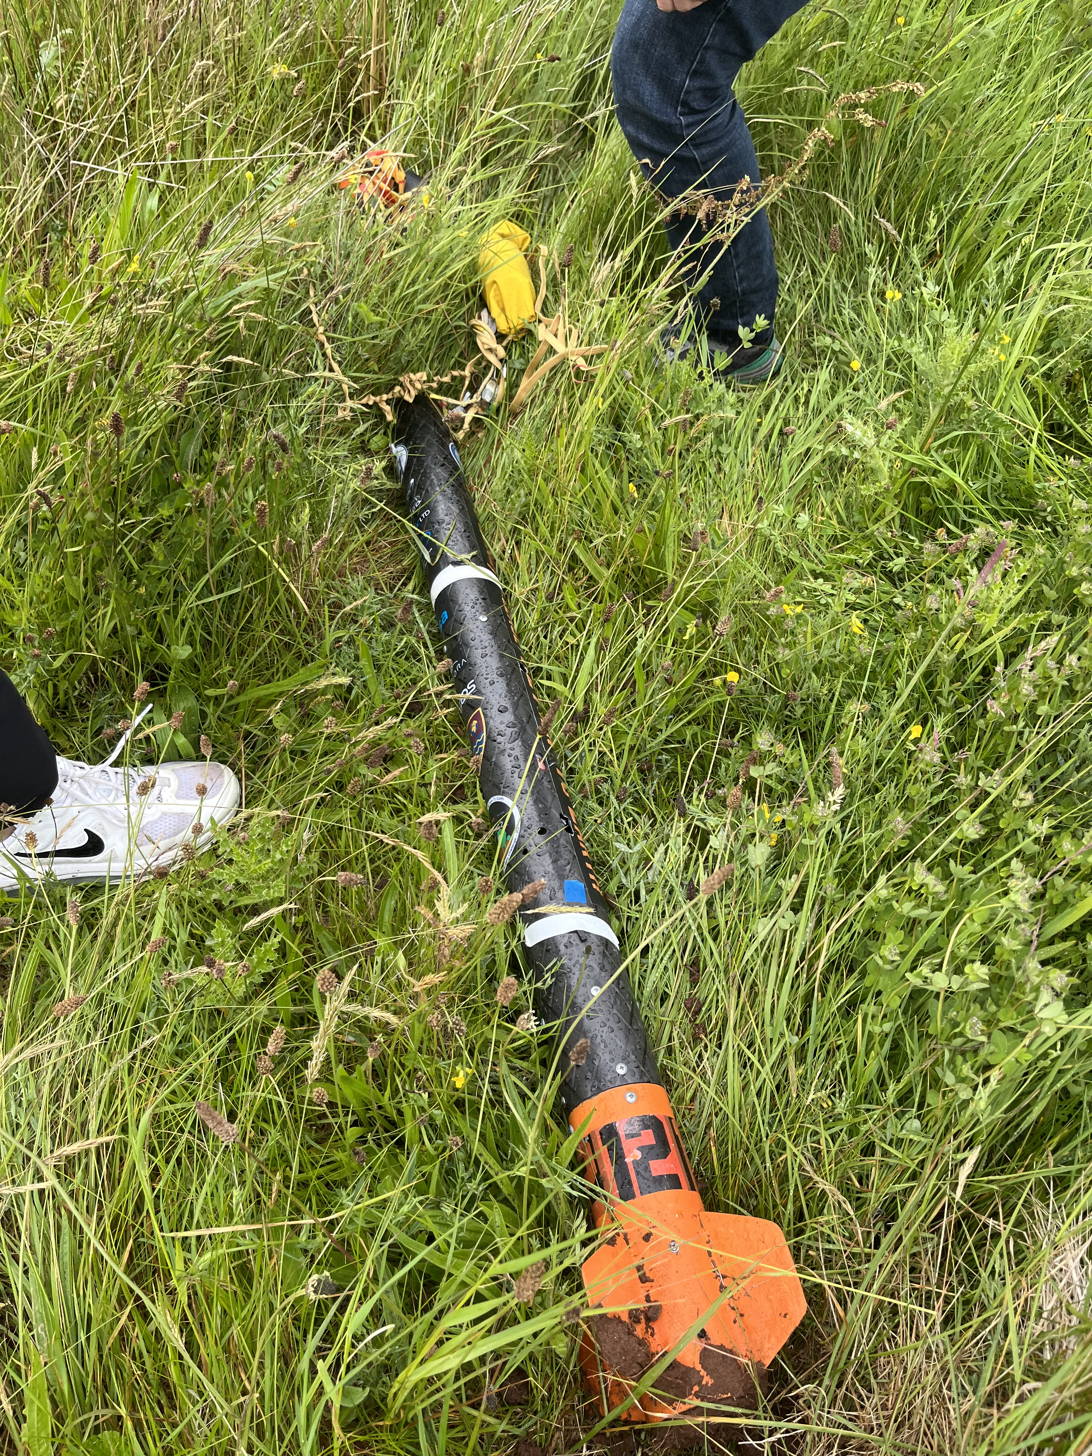
Both stages were recovered
Deployable payload… not so much

Slide 8
UKSEDS Olympus Rover Trials
Objective
Mars sample return mission
Team of 12
Autonomous rover
Task to traverse unknown environment with no external commands

Slide 9
UKSEDS Satellite Design Competition
Objective
3U CubeSat for space debris removal
Complex mechanical and avionics systems
Design lifetime of a couple of years: longevity of mechanisms
Team of 14

Slide 10
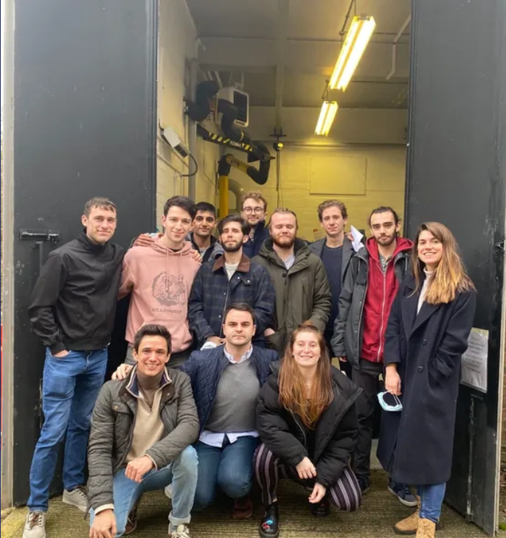
Research Project - Hybrid Rocket Motor Test Stand
Objective
Developing a 300 N hybrid rocket motor
Project started in September 2020; team currently has 30 members
High Density Polyethylene (HDPE) with Nitrous Oxide (N2O)
Future development
Integration of hybrid motor into a rocket (e.g. for future EuRoC entry)
Development of liquid motor

Slide 11
Everything else…

Slide 12
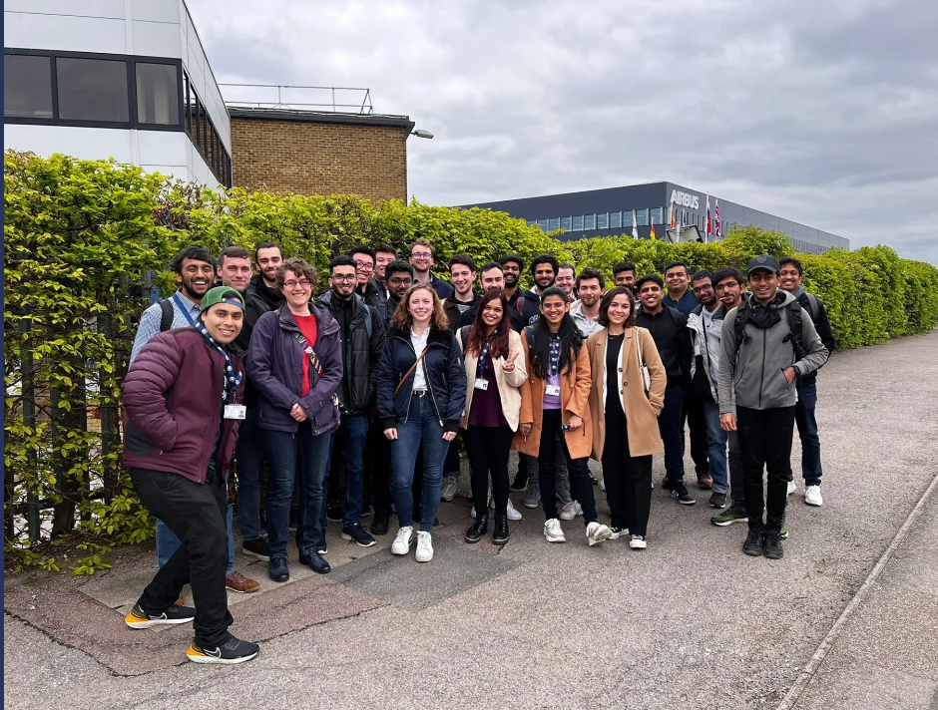
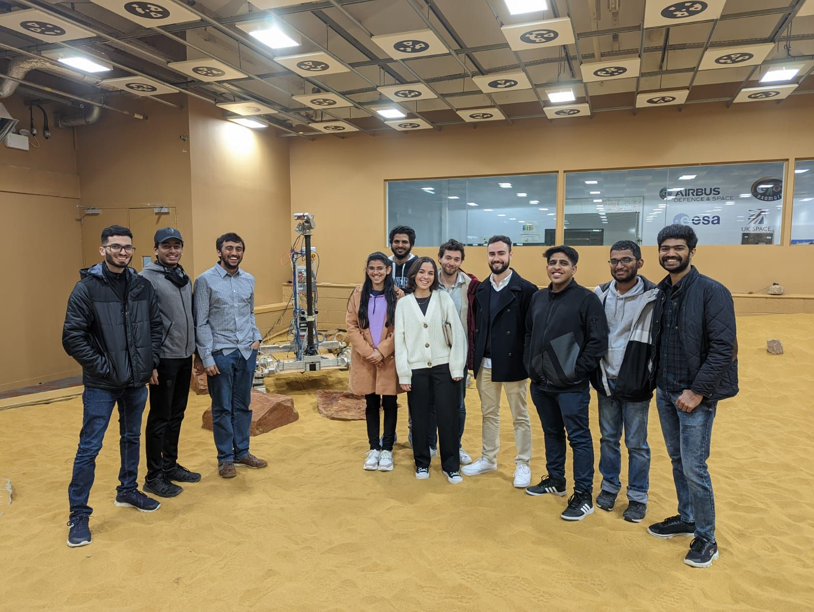
Visits
AIRBUS Facility @ Stevenage
Airbus Facility tour @ Stevenage

Slide 13
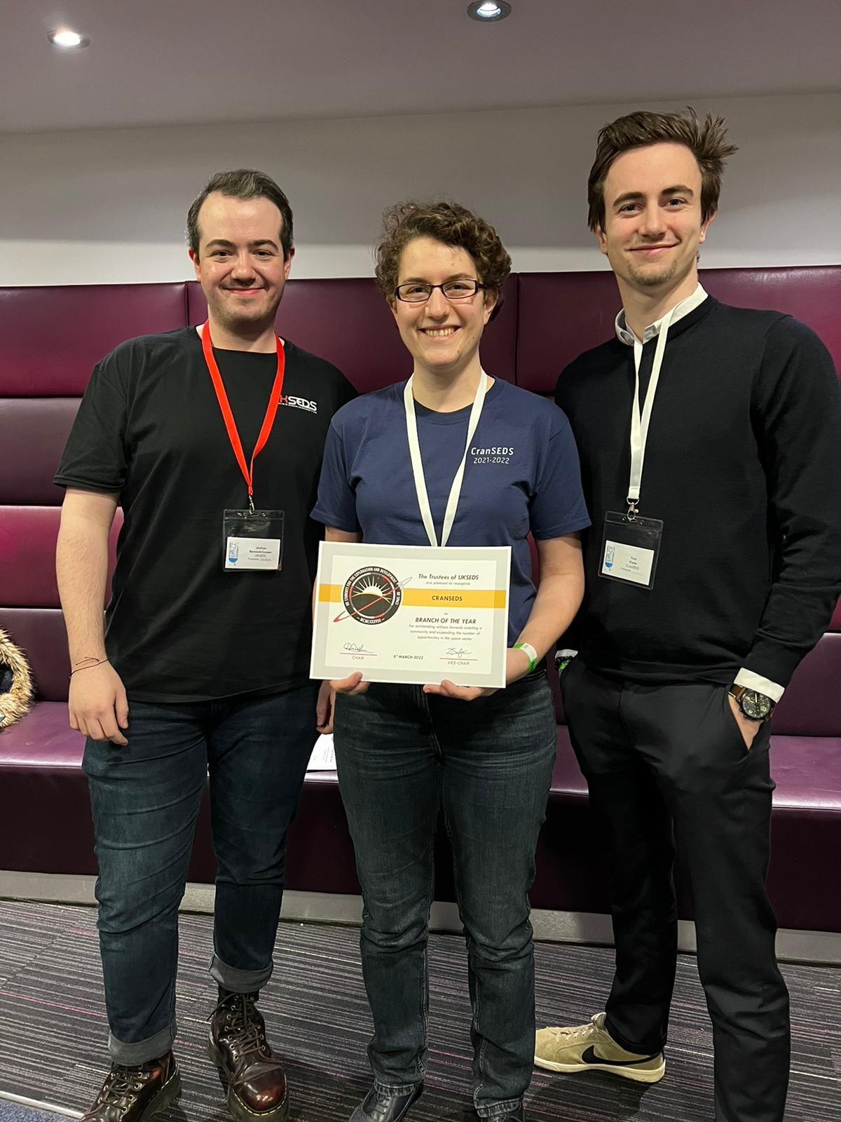
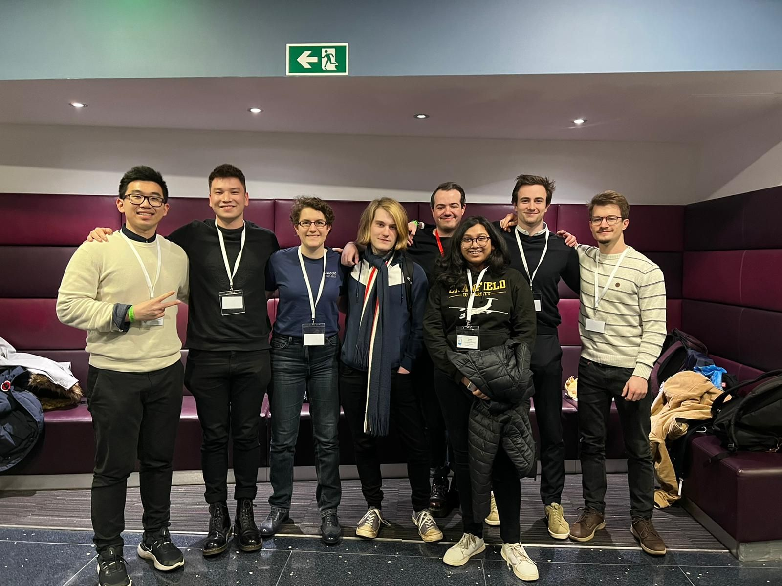
National Student Space Conference NSSC
We were awarded by the UKSEDS - UK Students for the Exploration and Development of Space Branch of the Year at the 34th Annual National Space Student Conference NSSC hosted by KCL Space at King's College London this year!

Slide 14
Outreach
Both with Biddenham International School
STEM Talks and Mentoring programme
Talks from female engineers of all ages and experiences
Mentoring for CREST Award Projects
Mars Rover Workshop
Design and launch a Mars rover in 1 hour

Slide 15
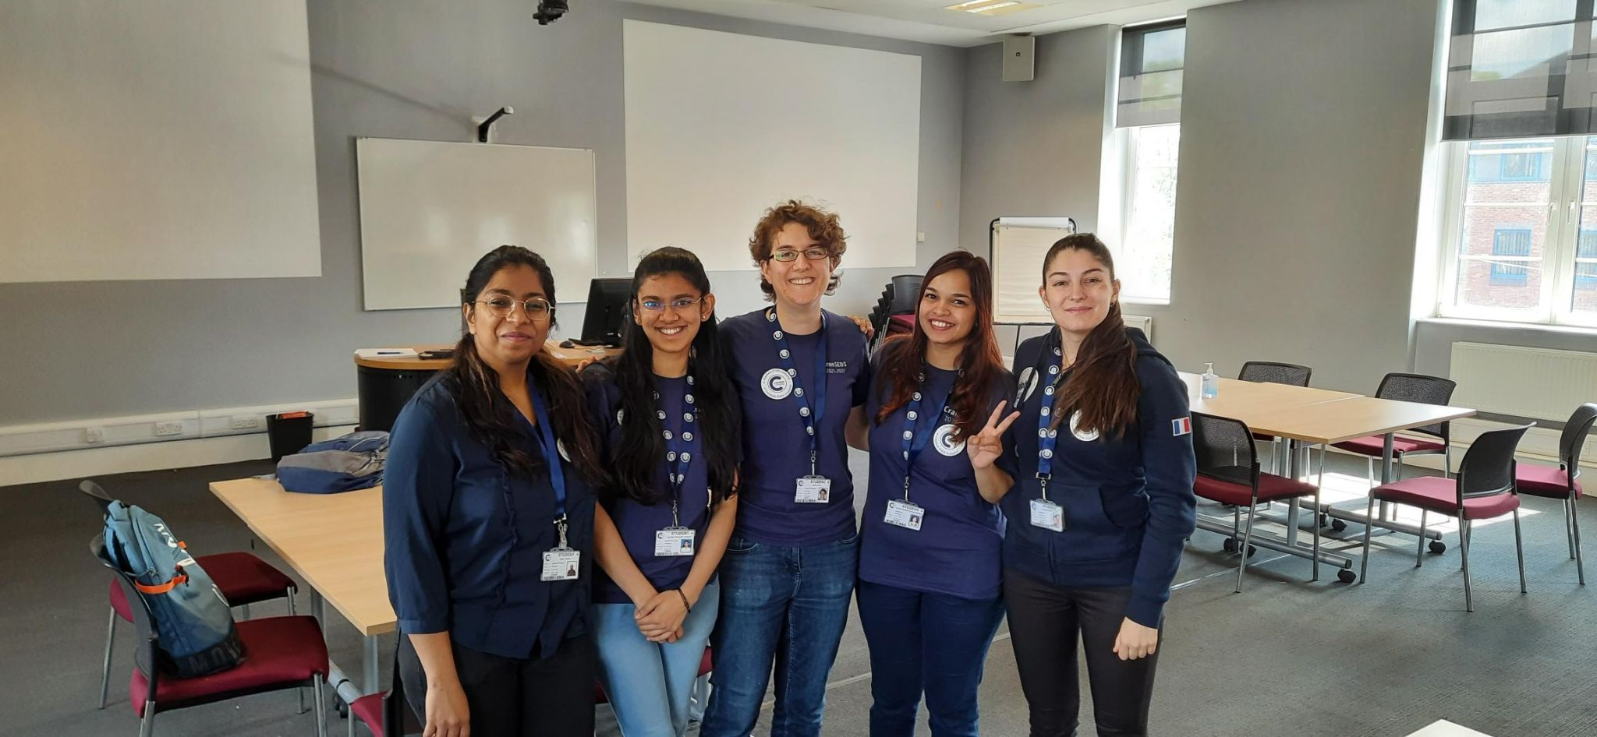
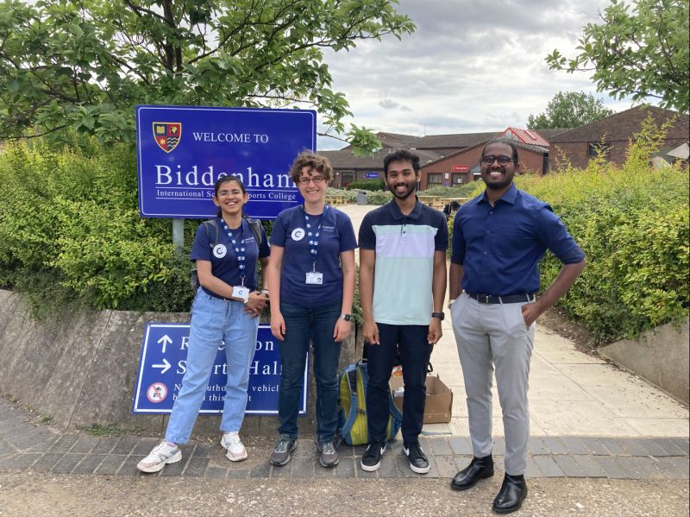

Slide 16
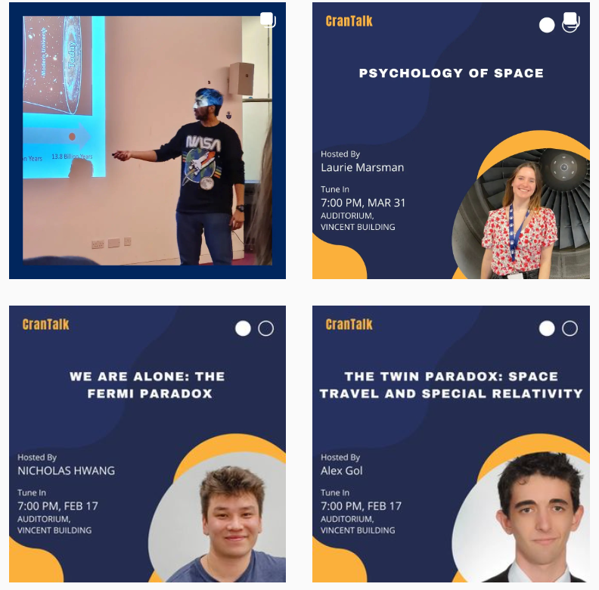
CranTalks
Fortnightly talk series
By CranSEDS students, for CranSEDS students
Topics involved
Individual research projects
Engineering
Physics
Popular science
Science Communications

Slide 17
1,2,3…Get Set Launch!!
3.2Kms
500m approx.

Slide 18
Thank you for listening!
Email: cranseds@cranfield.ac.uk
Website: cranseds.co.uk
LinkedIn & Instagram: @cranseds

